Slide 1
Instagram User Analytics
Zaid Mohammad

Slide 2
Project Description
This project dives into understanding how users interact and engage on Instagram. Using SQL, we pull out useful insights about user activity, spot trends in engagement, and even identify potential bot behavior. The results help the team make smarter decisions about improving the platform and shaping marketing strategies.

Slide 3
Approach
Setting Up the Database:
I started by creating and filling tables (like users, photos, and likes) in MySQL Workbench to organize the data.
Digging into the Data:
Using SQL queries, I explored key metrics such as active vs. inactive users, how often people post, and even flagged potential bot activity.
Making Sense of the Results:
After running the queries, I compiled the outputs, analyzed the trends, and turned them into practical insights that could drive decisions.

Slide 4
Tech Stack
MySQL Workbench: For managing the database and running all the SQL queries.
SQL: The go-to tool for fetching and analyzing the data.
PowerPoint: To neatly organize and present the findings in a way that’s easy to understand.

Slide 5
Database Schema
Tables Used:
users
photos
likes
comments
tags
photo_tags

Slide 6
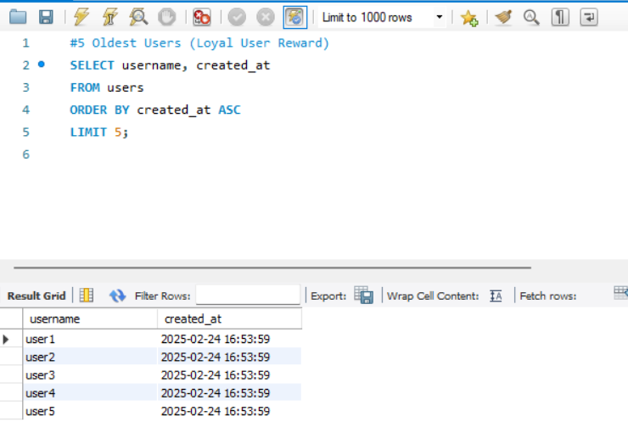
Key SQL Queries & Results
1. Identifying the Five Oldest Users
Result:
Displays the five oldest users on Instagram.

Slide 7
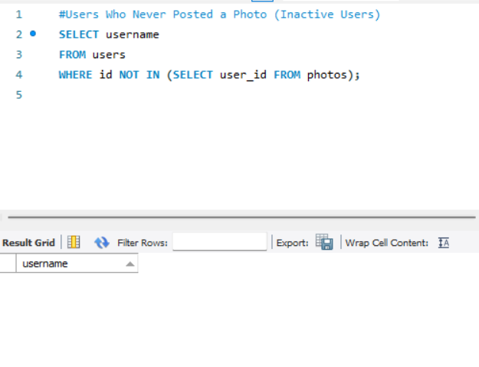
2. Finding Users Who Never Posted a Photo
Result:
List of users who have never posted a single.

Slide 8
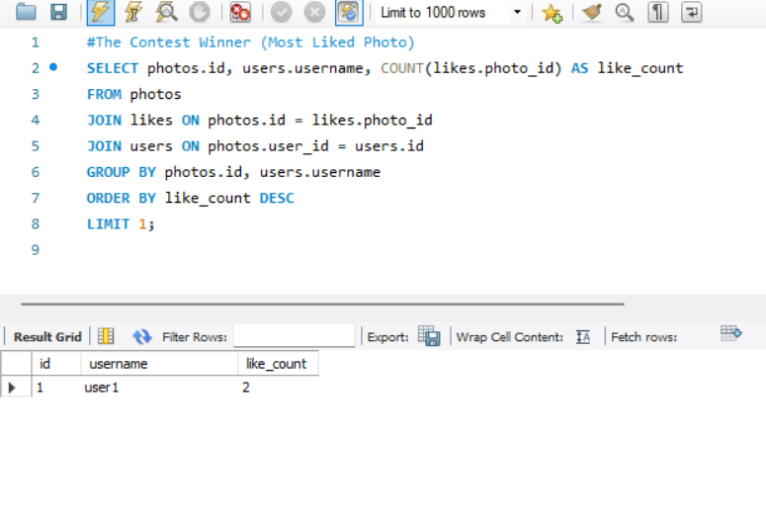
3. Contest Winner: Most Liked Photo
Result:
Displays the winner of the contest (user with the most likes on a single photo).

Slide 9
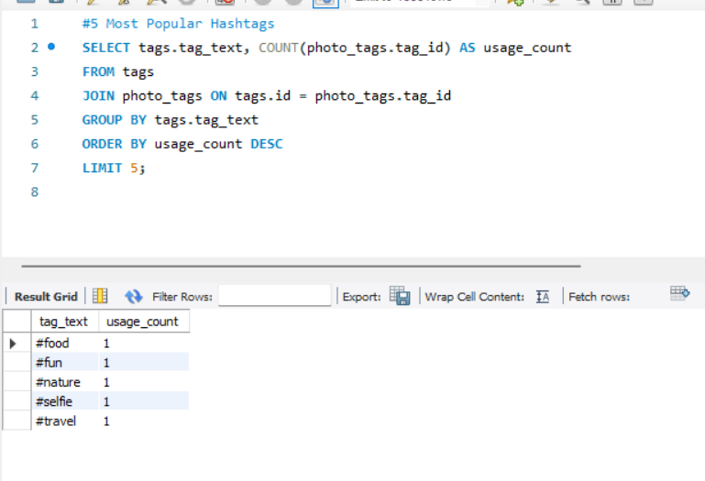
4. Identifying the Top 5 Most Popular Hashtags
Result:
Displays the five most commonly used hashtags.

Slide 10
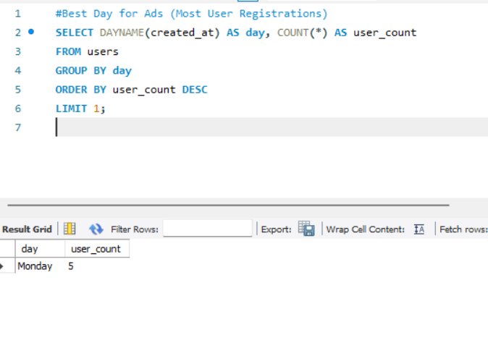
5. Best Day for Ads (Most User Registrations)
Result:
Identifies the best day of the week to launch ad.

Slide 11
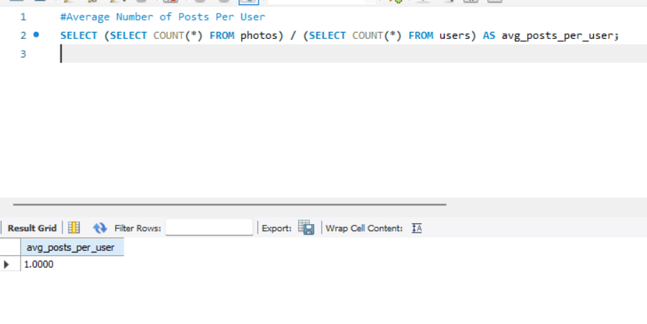
6. Average Number of Posts Per User
Result:
Displays the average number of posts per user.

Slide 12
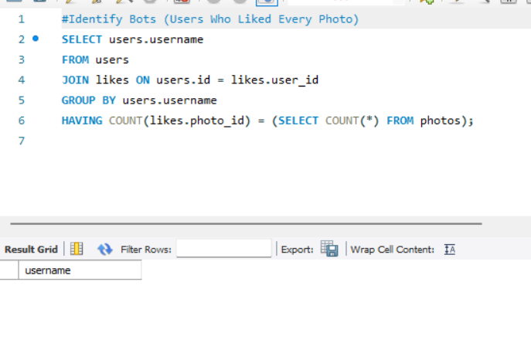
7. Identifying Bots (Users Who Liked Every Photo)
Result:
Identifies users who have liked every single photo (potential bot accounts).

Slide 13
Insights
The five oldest users were identified based on their account creation dates.
Some users have never posted a single photo, indicating inactive accounts.
The contest winner was determined based on the highest number of likes on a single photo.
The most popular hashtags were identified to help brands maximize their reach.
Monday was found to be the best day for launching ad campaigns based on user registrations.
The average number of posts per user was calculated to determine overall engagement.
Potential bot accounts were searched for.

